Slide 1
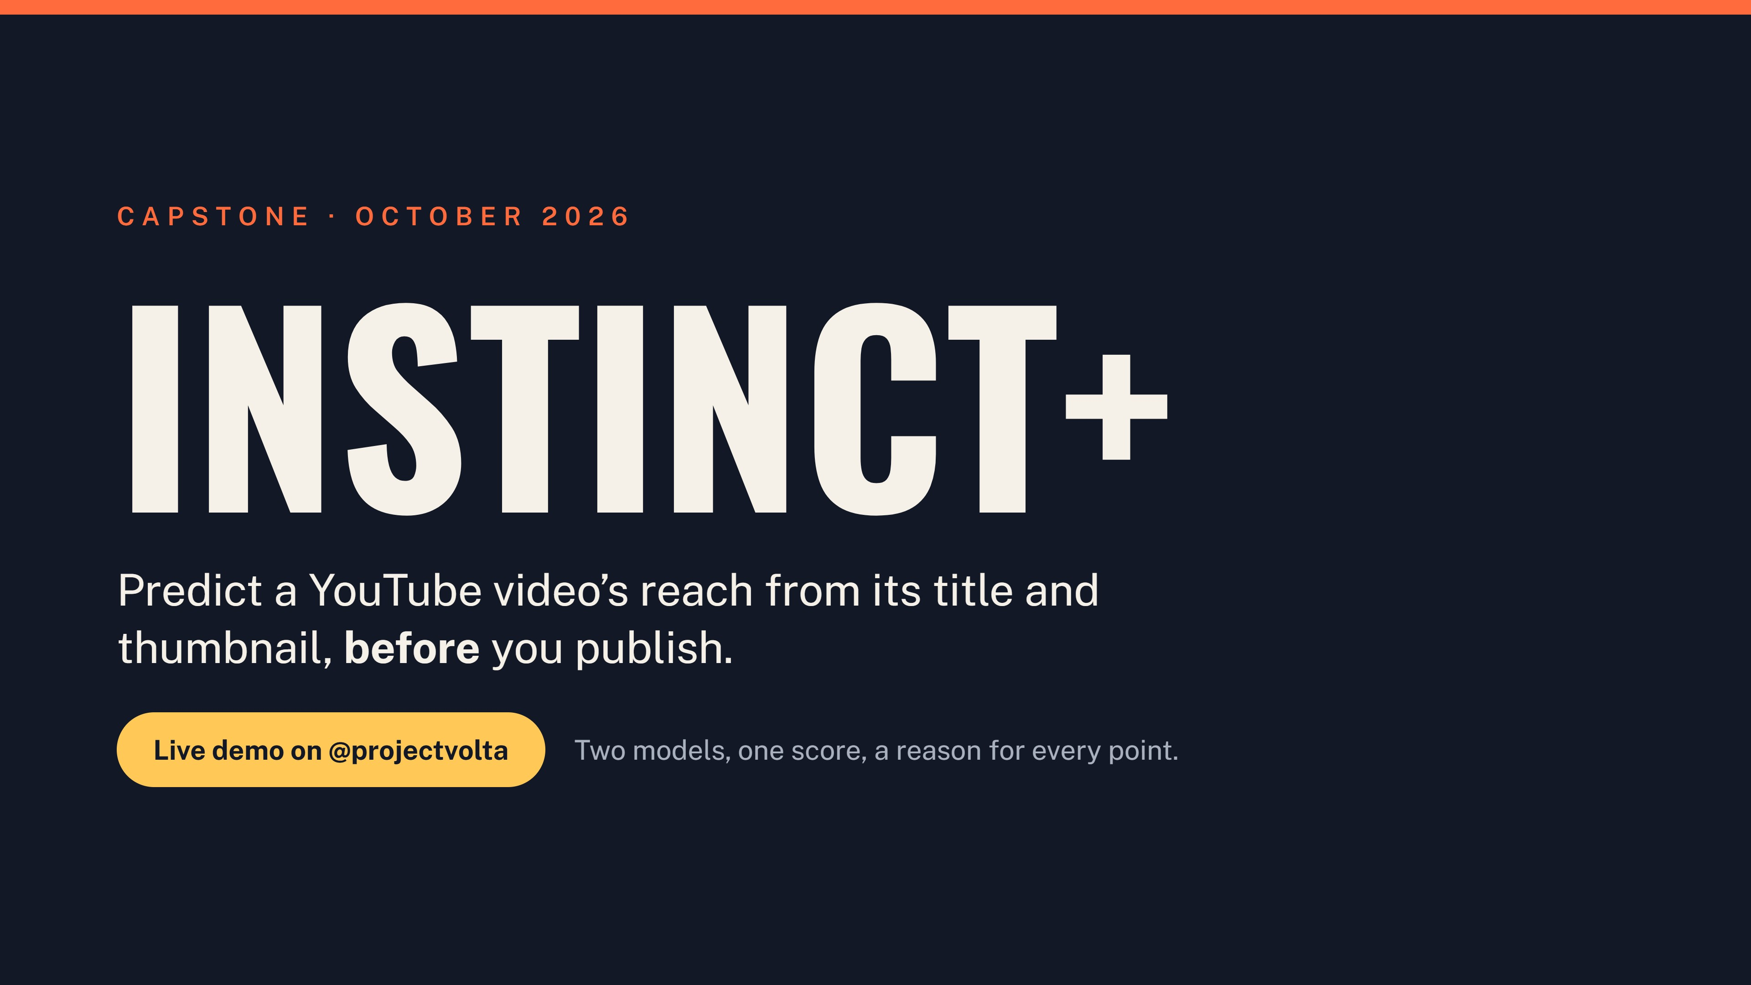
Notes:
Instinct+ predicts how far a YouTube video will reach from its title and thumbnail alone, before it goes live. We will finish with a live demo on the Project Volta channel.

Slide 2
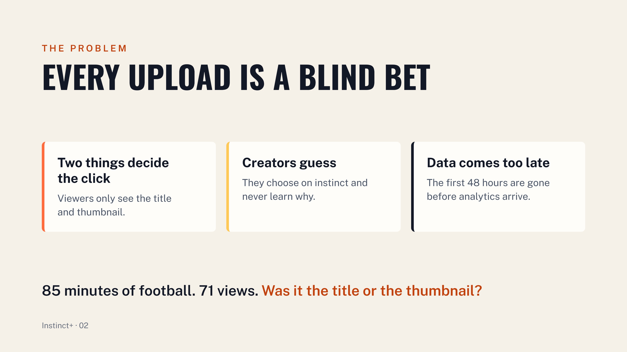
Notes:
The title and thumbnail are all a viewer sees before choosing, so the video itself never gets a vote. Creators choose on instinct, then wait a week to learn whether the packaging worked, with no way to tell why. By the time analytics arrive, the first 48 hours that decide reach are gone. Example: an 85 minute match upload got 71 views, and nobody can say whether the match, the title or the thumbnail was the cause.

Slide 3
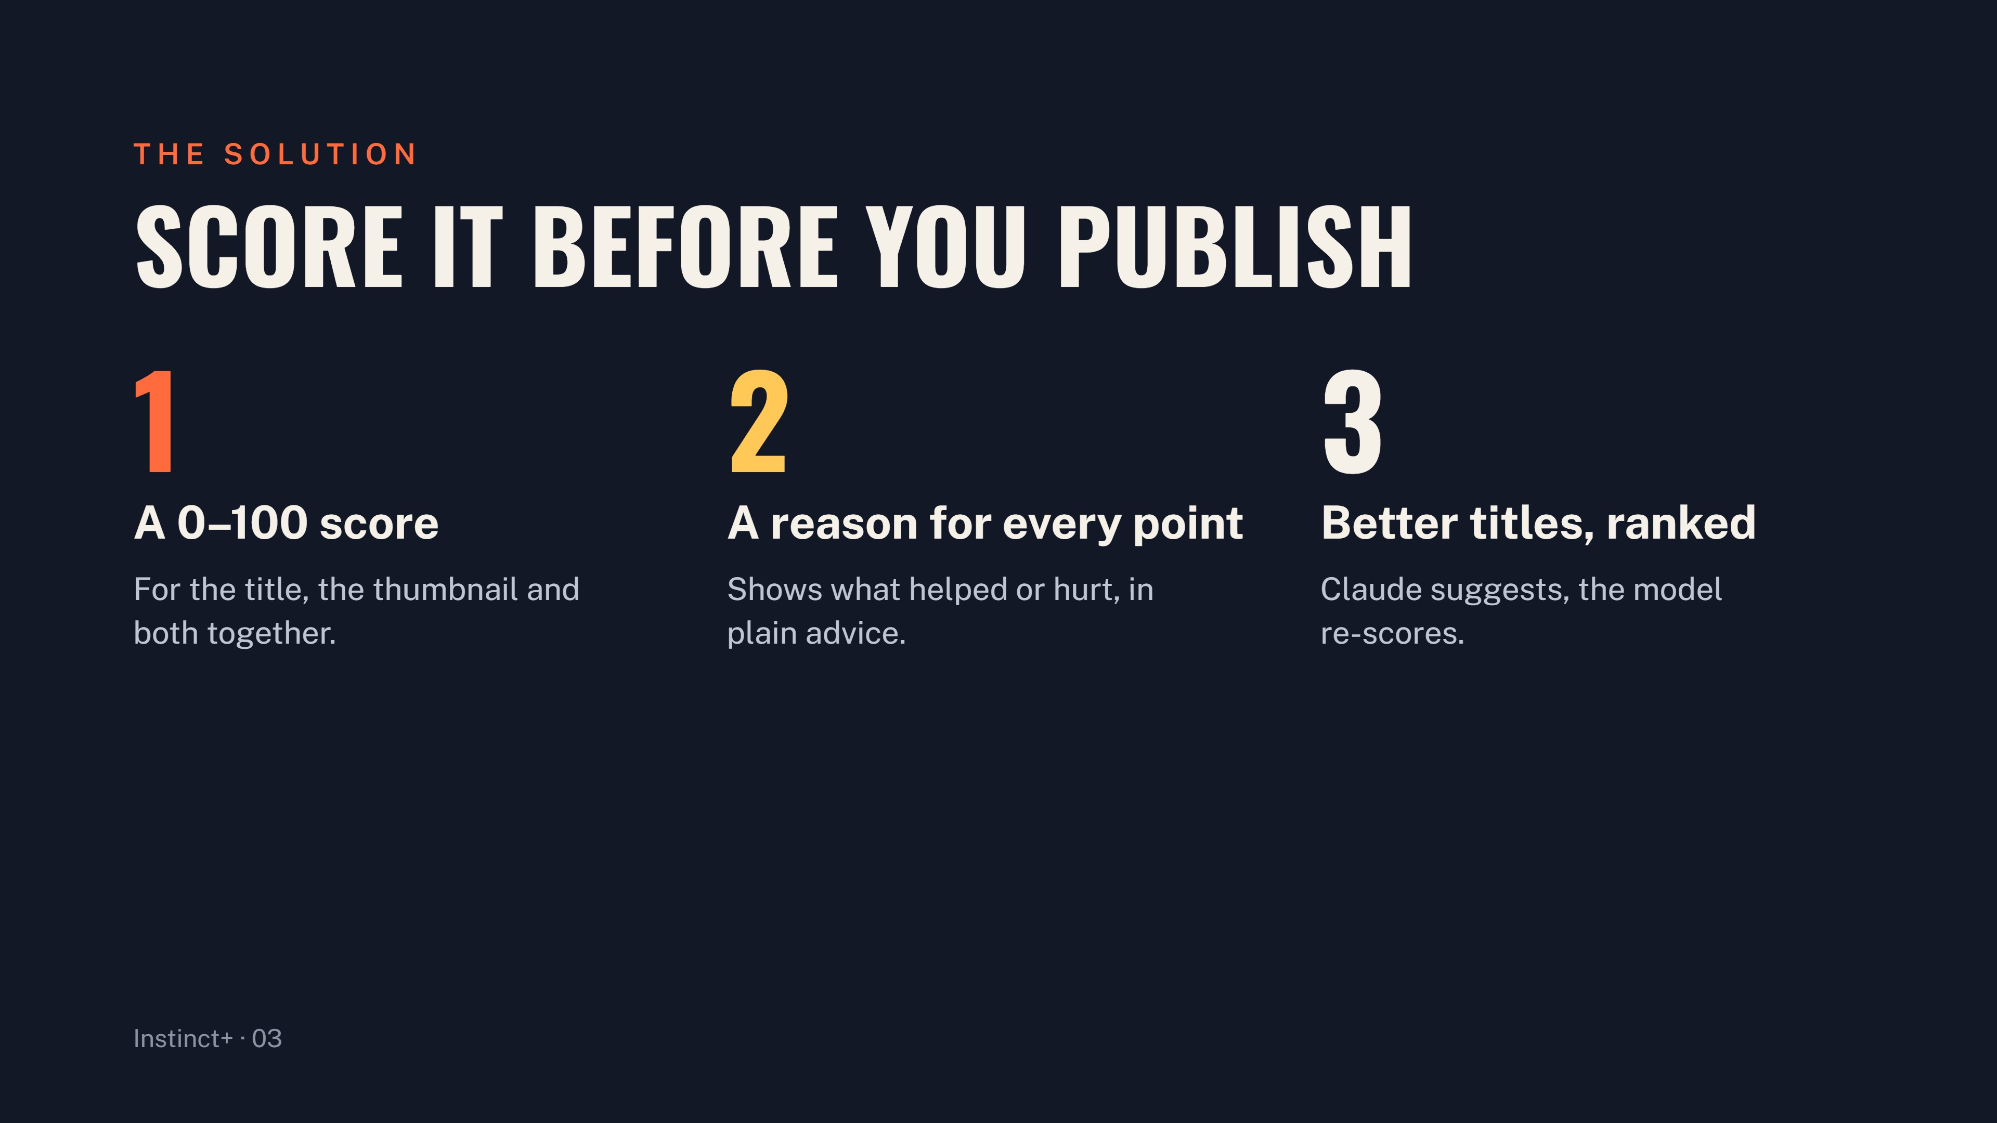
Notes:
A score of 70 means better than 70% of videos in the same category. Drivers show which features helped or hurt, in points, and are turned into plain advice. Claude writes alternative titles that fix the weaknesses, and the same model scores and ranks them, so the creator can swap in one click.

Slide 4
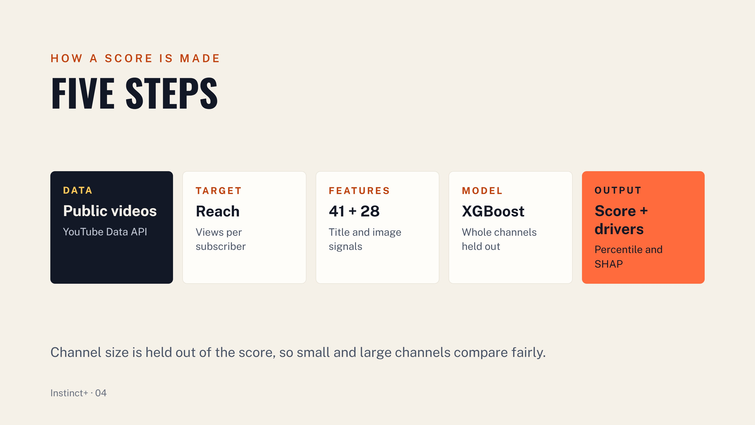
Notes:
Data: public videos from seed channels in four categories, 30 to 365 days old, no Shorts. Target: views per subscriber on a log scale, adjusted for age, which is fair to small and huge channels. Features: 41 title and 28 image features, each something a creator can change. Model: XGBoost, one model per input, cross-validated with whole channels held out. Output: a percentile within the category, with SHAP values turned into points and sentences. A 150 subscriber channel and a 5 million subscriber channel compare the same title on equal terms.

Slide 5
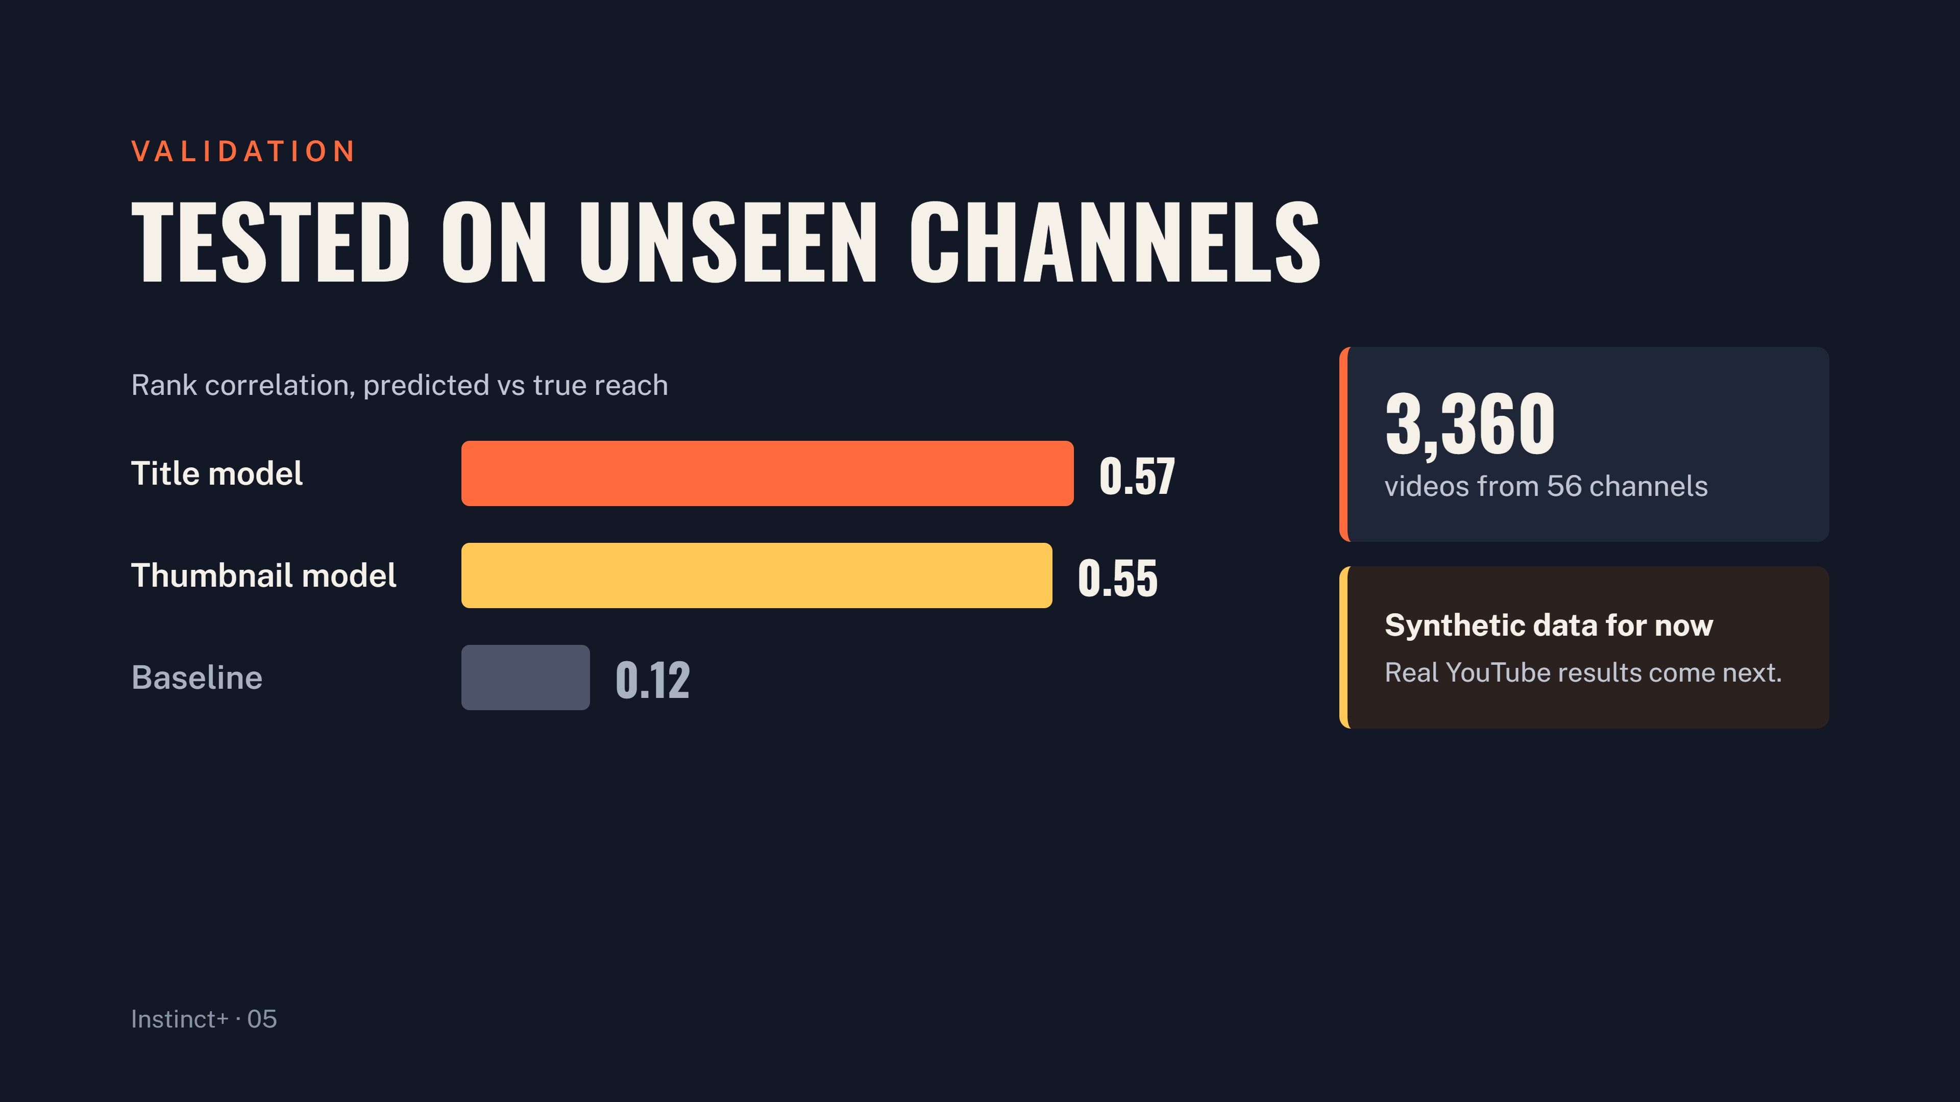
Notes:
Spearman rank correlation, out of fold, five folds grouped by channel, so every score is on a channel the model never saw. The category mean baseline reaches only 0.12. Mean true percentile rises from 30 in the lowest score bucket to 71 in the highest, so the 0 to 100 scale is honest. These numbers are on synthetic data and show the pipeline recovers known rules; real YouTube numbers come with the first collection run.

Slide 6
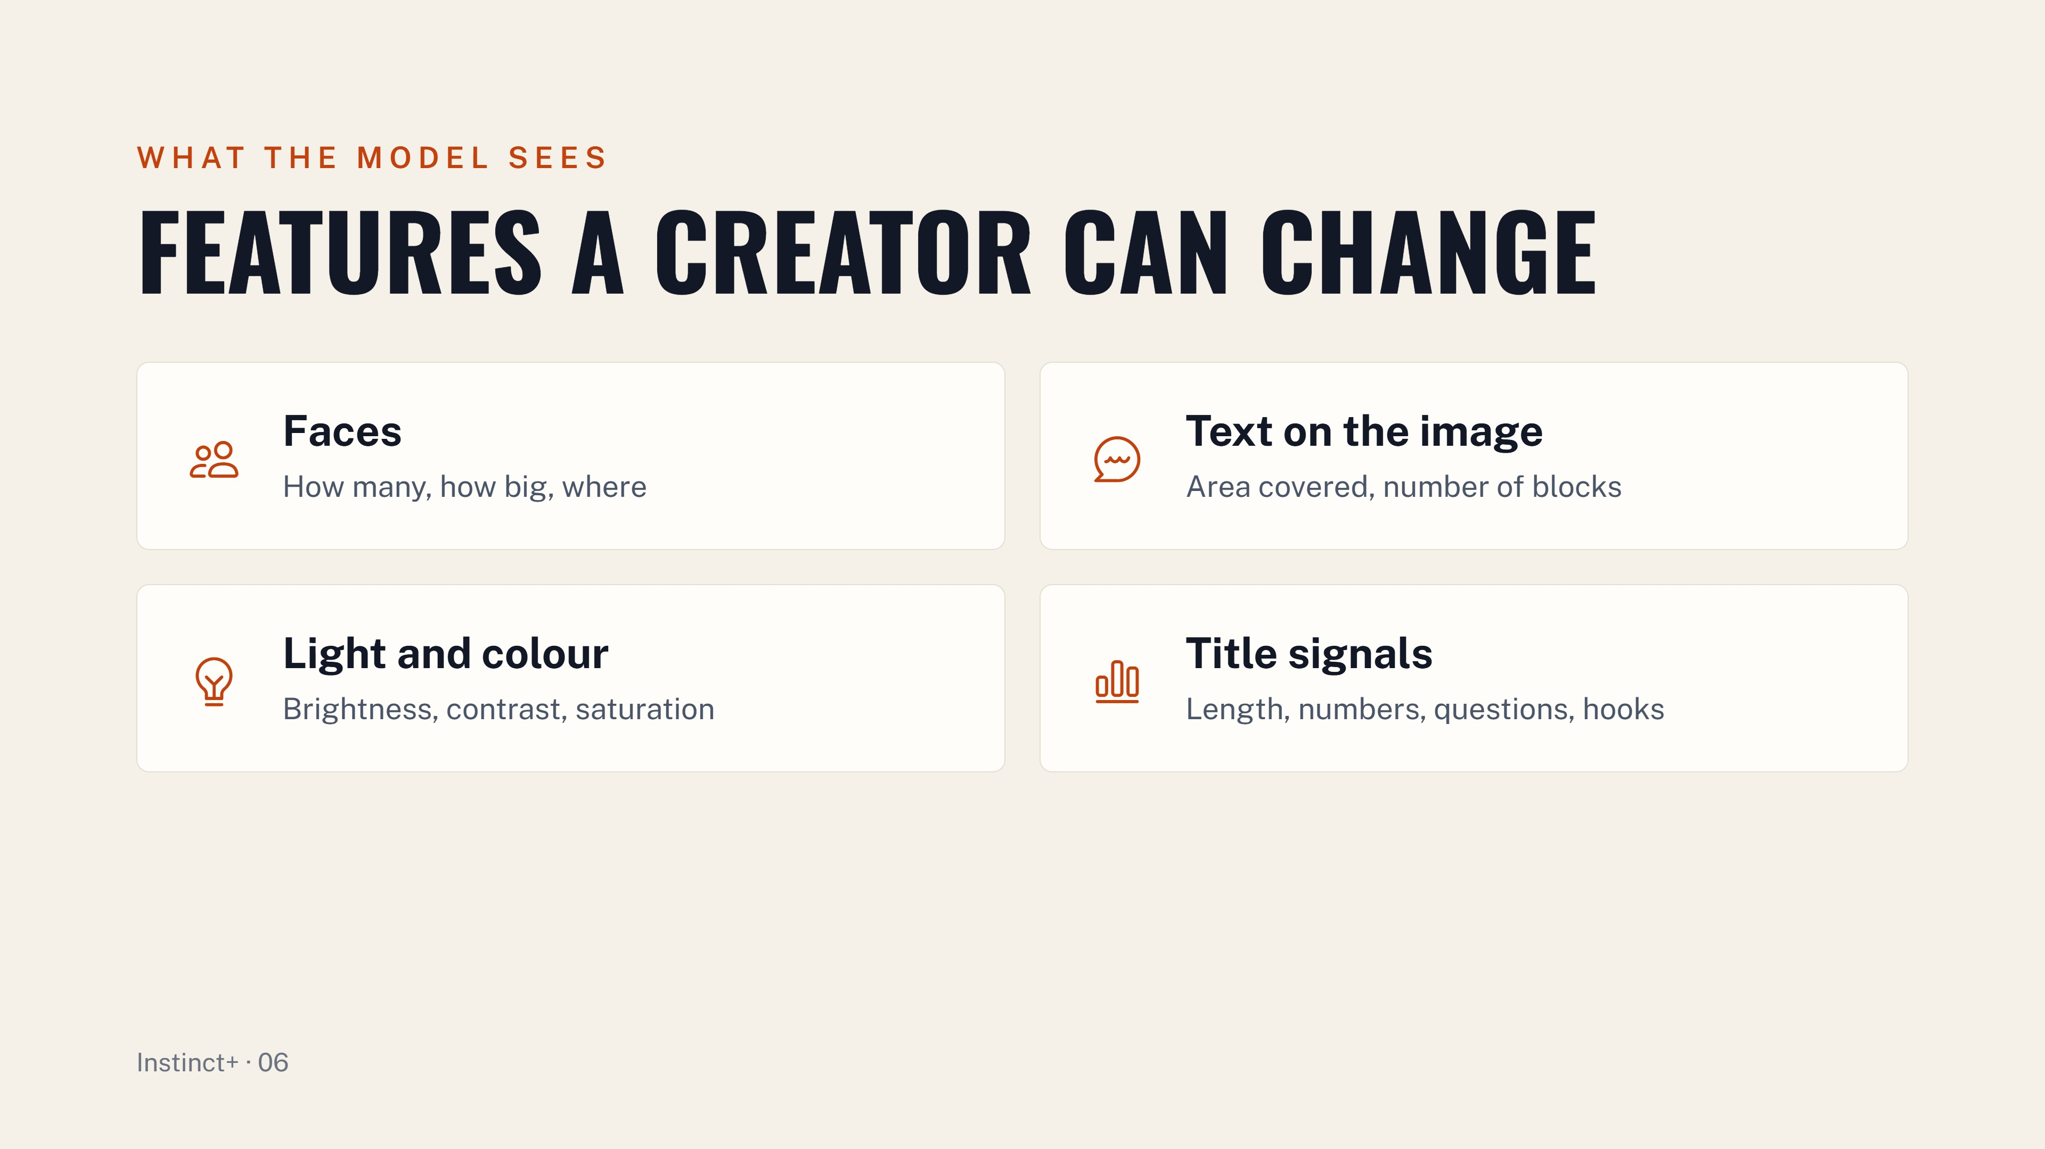
Notes:
Faces: present, count, size and position. Text on the image: area covered and number of text blocks. Light and colour: brightness, contrast, saturation, warm share and palette size. Title signals: length, numbers, questions, capitals, power words, curiosity hooks and sentiment. All are measured in milliseconds with no deep model, and every one is something a creator can change.

Slide 7
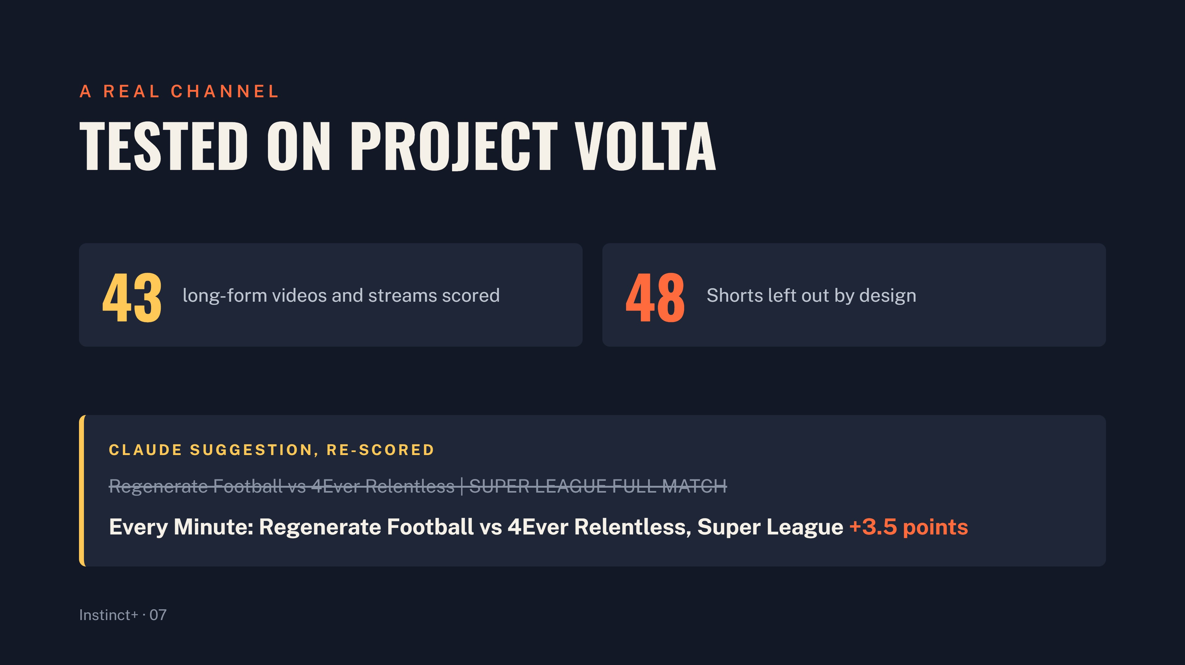
Notes:
Scored with no API key needed. Shorts are a different surface, so they are out of scope by design. What the model keeps saying about this channel: the match thumbnails are strong, the template titles are interchangeable, and streams with a number and an event in the title score highest.

Slide 8
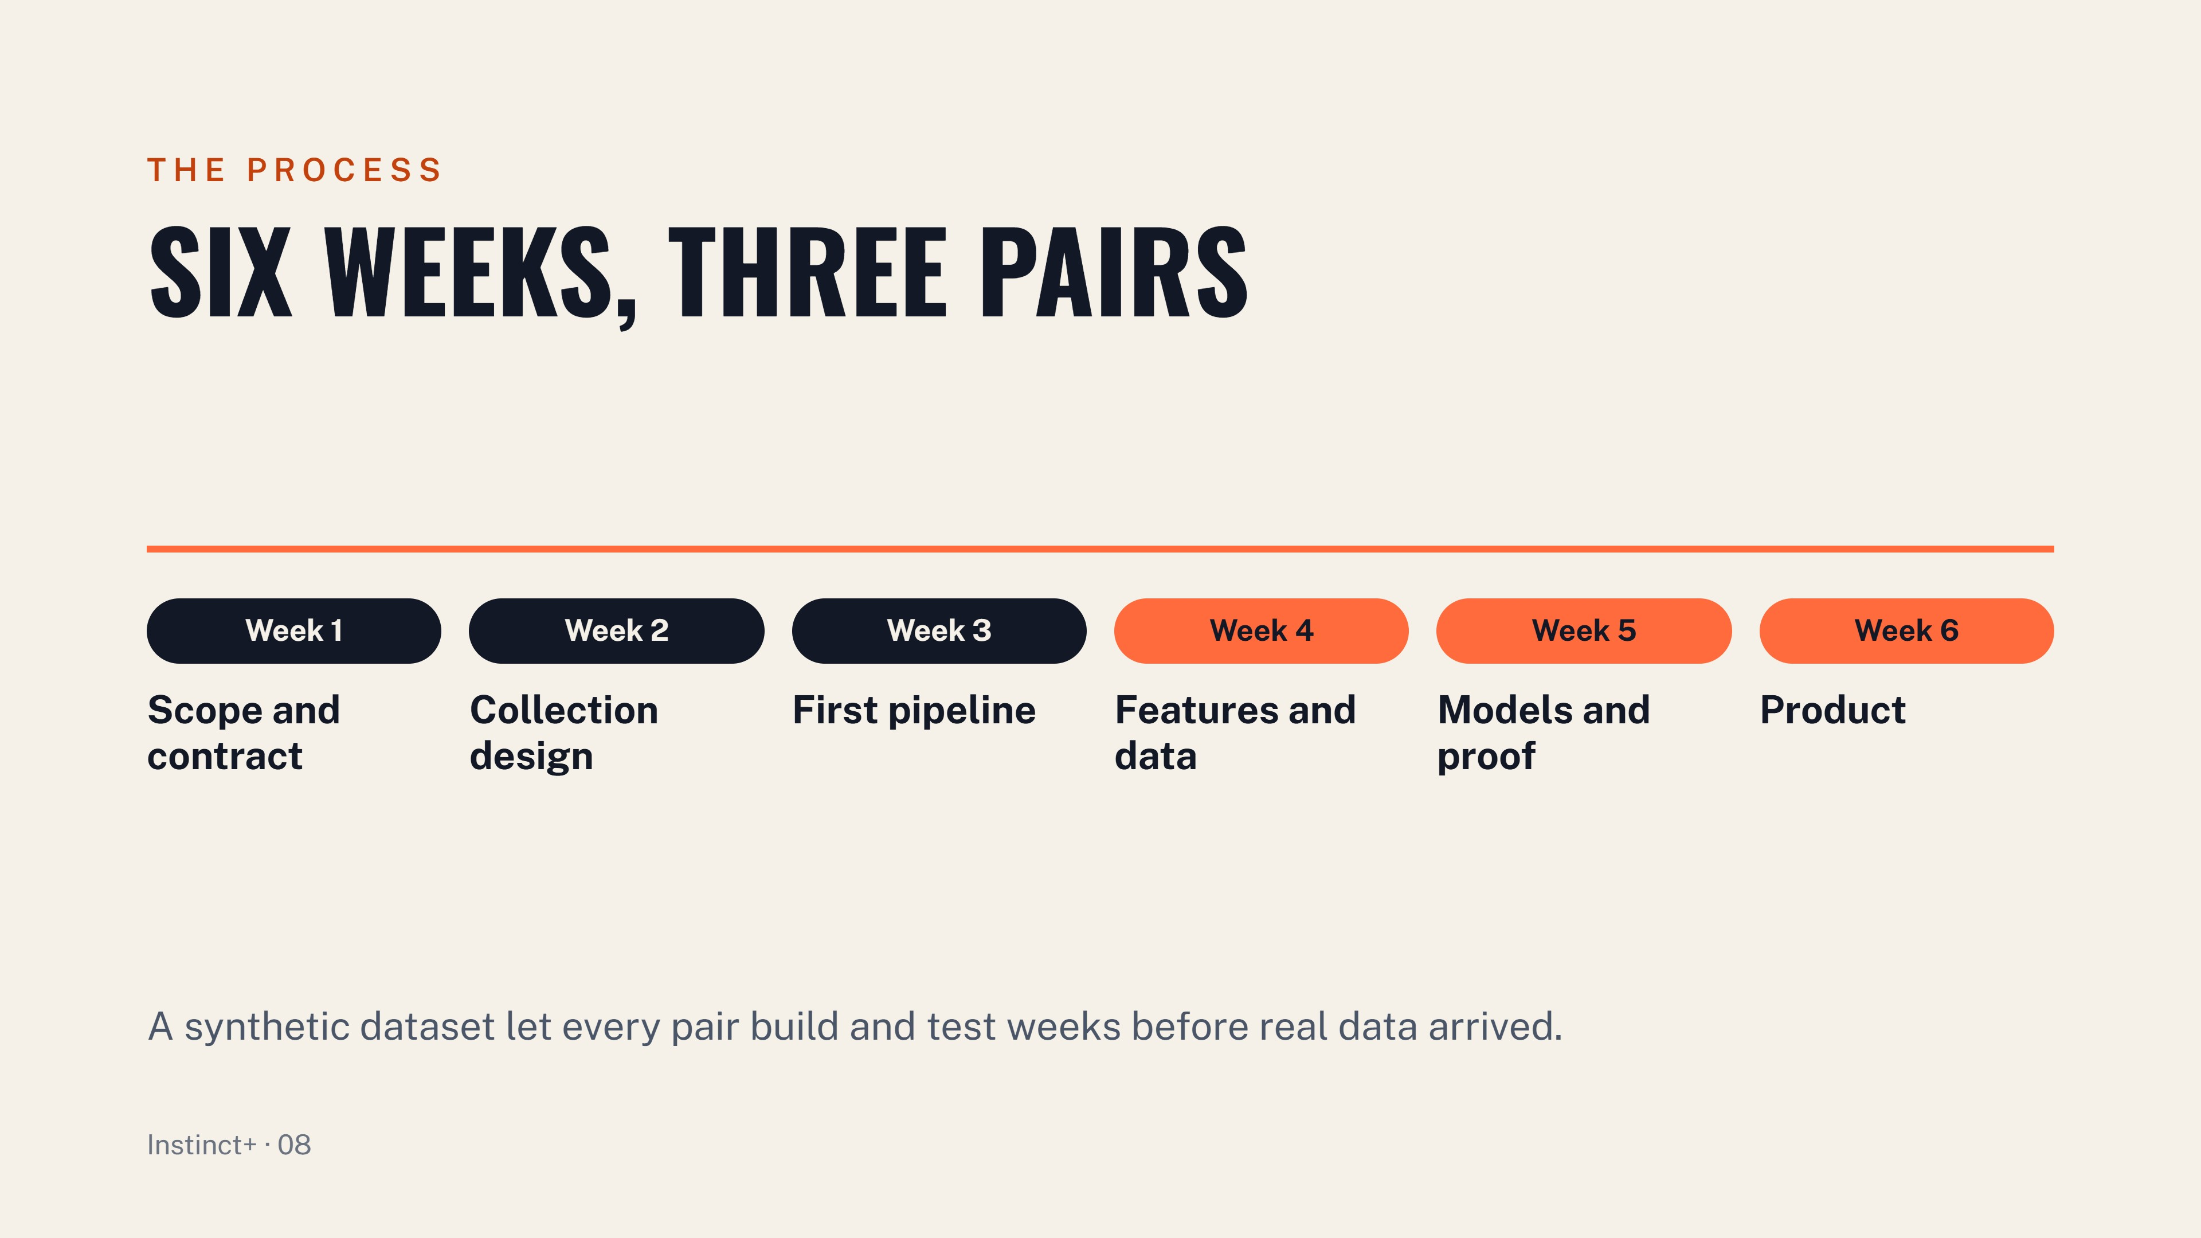
Notes:
Week 1: shared schema and the ScoreResult interface agreed by all three pairs. Week 2: seed channels over search, 30 to 365 day window, Shorts out. Week 3: collector, placeholder scorer and contract tests so the app could start. Week 4: title and image feature dictionaries, plus a synthetic dataset to unblock everyone. Week 5: boosted trees, channel grouped cross-validation, SHAP drivers and the validation protocol. Week 6: Streamlit app, Claude suggestions, A/B and batch modes, and the channel check on Project Volta. The synthetic set holds 3,360 drawn thumbnails and template titles with a written down hidden rule, and it is flagged on every artefact it touched.

Slide 9
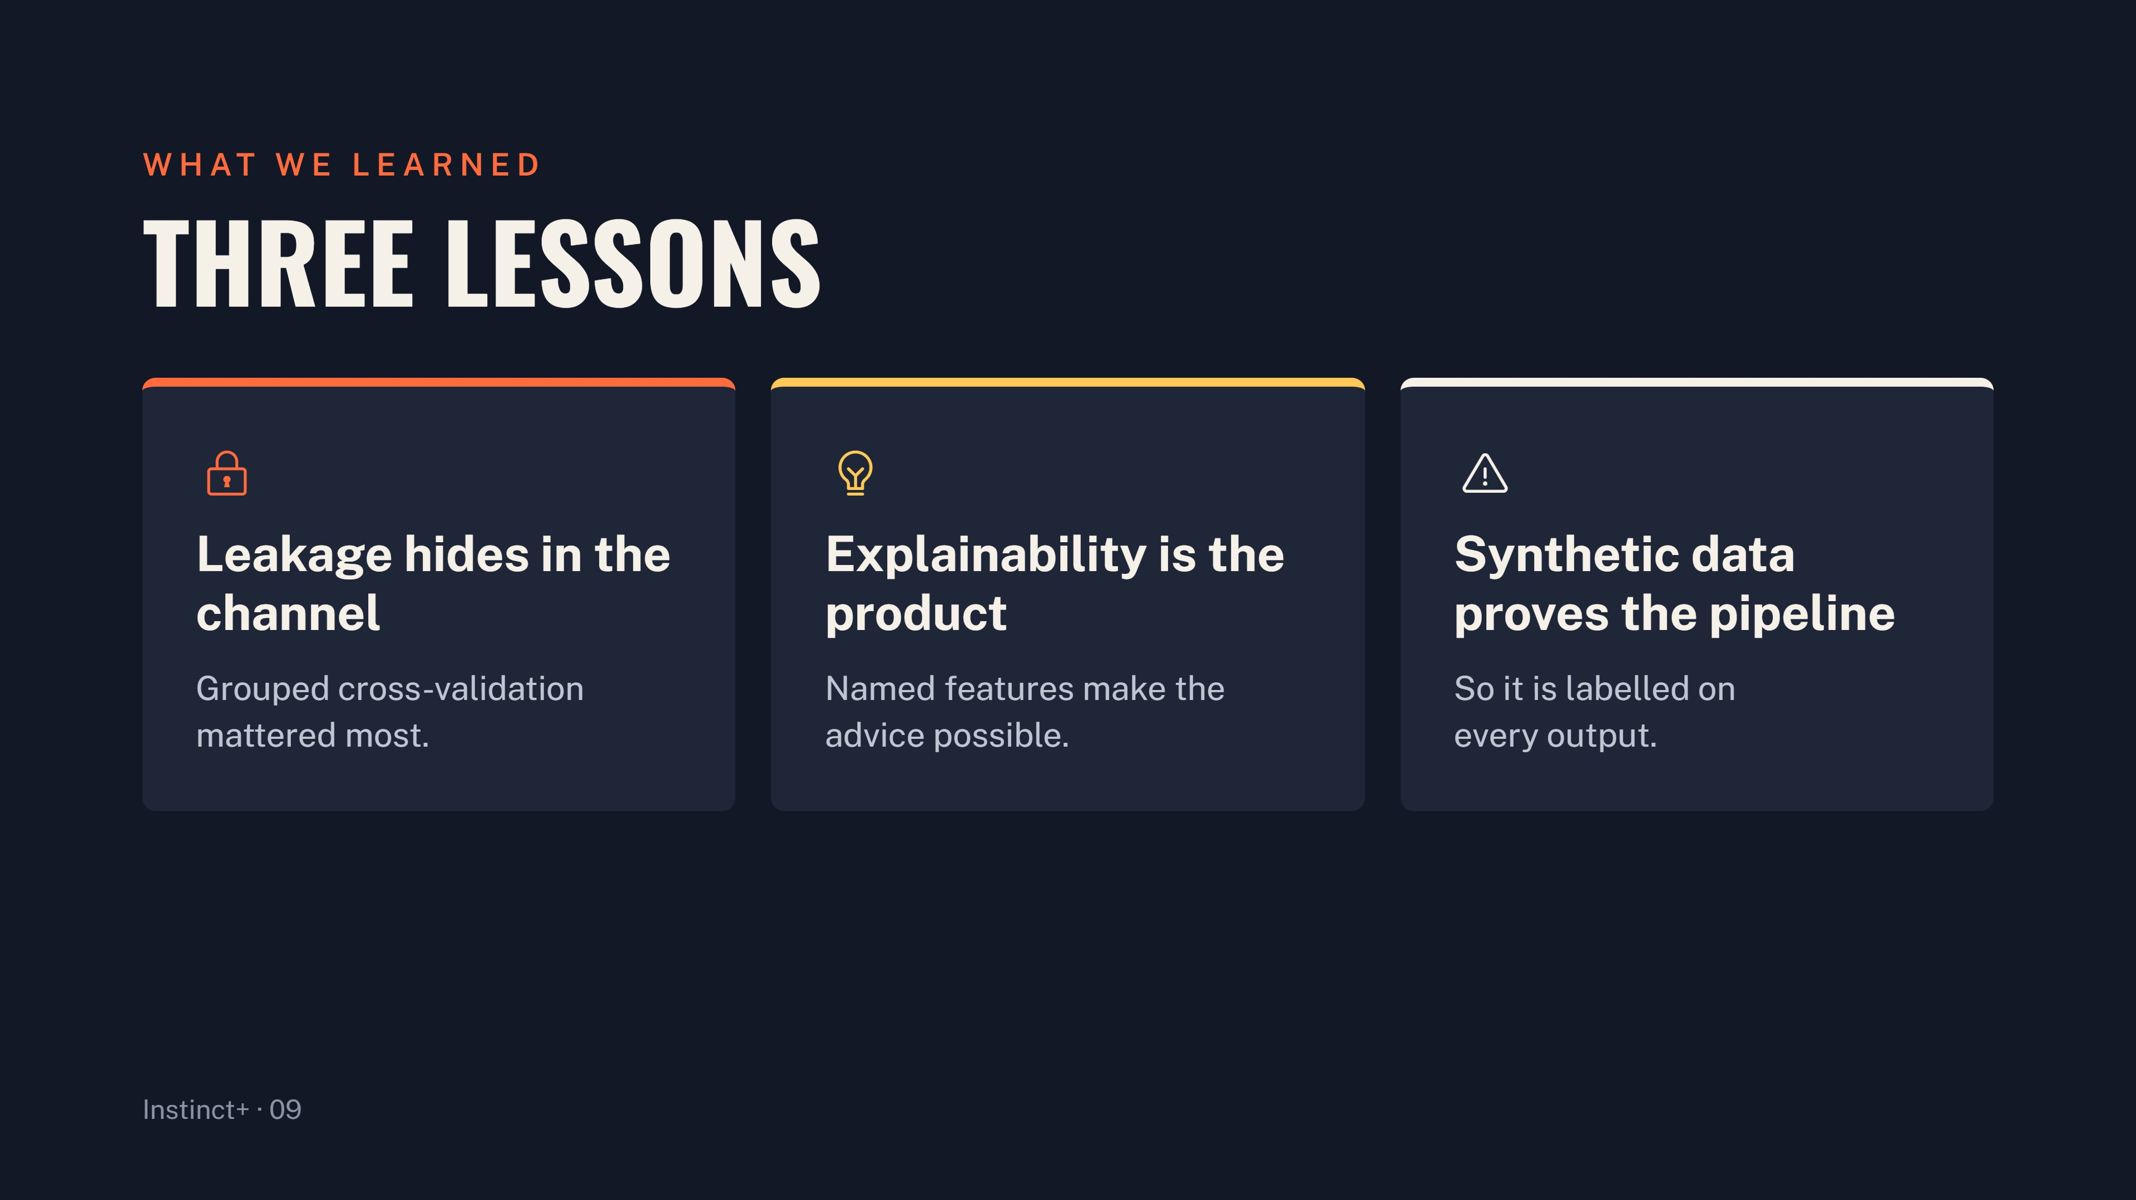
Notes:
A model that sees a channel in training learns its style, not its packaging, so grouped cross-validation was the single most important decision. A creator cannot act on an embedding; named features cost some accuracy and bought every sentence of advice the app gives. Synthetic data unblocked three pairs for weeks, but it proves the pipeline, not the claim, so it had to be labelled everywhere so nobody mistakes a demo score for a prediction.

Slide 10
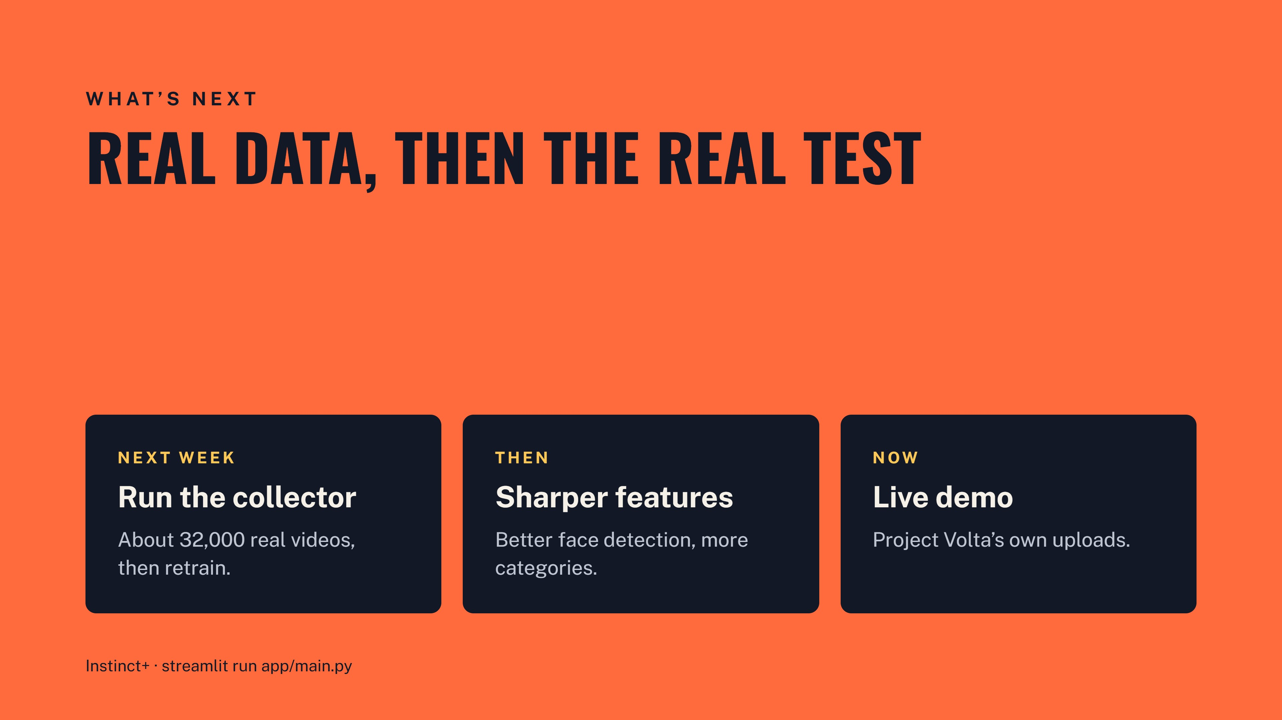
Notes:
Next week: run the collector for about 32,000 videos at 1,300 API units, retrain, re-run the validation protocol and publish the model card. Then: MediaPipe faces, a few named semantic title axes and more categories, keeping the same feature names and the same contract. Now: the live demo on Project Volta’s own uploads, showing a template title, a strong stream and what Claude suggests instead.

